Slide 1
ACA Risk Adjustment EHR Data Validation Tool
FHIRed Up
Augusto Burgos
Spiro Ganas
Anja Guillory
Jamie Richgels
Daniel Stoneburner
Tala Suidan

Slide 2
Background Information
Risk Selection occurs when insures try to avoid enrolling unhealthy people by making their products unattractive to people requiring costly medical care.
Risk Adjustment discourages risk selection by transferring premiums from insurers with healthy members to those with members who are more ill.

Slide 3
Risk Scores
Risk Scores are an estimate of a individuals future medical costs.
Recent diagnostic history is the most important data individual’s risk score.
Other predictors include the individual’s geographic area, age/gender and the type of insurance policy (high-deductible, low co-pays, etc.)

Slide 4
The problem
Recent diagnostic history is defined as the set of diagnosis codes that have been submitted to the insurer during the past calendar year.
If a member has an illness, but the diagnosis code is not reported to the insurance carrier during the calendar year, their risk score will be artificially low.
This data quality issue can substantially reduce an insurer's premiums. When provider payments are on a percent-of-premium basis, it also reduces payments to hospitals and doctors.

Slide 5
The Solution
FHIR will be used to extract member IDs and diagnosis codes.
Diagnosis codes will be groups into on of the 79 Hierarchical Condition Categories (HCC), by calendar year.
This data will then be analyzed to identify HCCs that represent chronic conditions.
Members with a chronic condition who have not had that condition reported in the current calendar year will be flagged.

Slide 6
The Solution – Part 2
In Massachusetts, risk scores are currently calculated using data available in the state’s All-Payer Claims Database (APCD)
The APCD contains data provided from health insurer claims systems.
APCD data does not always match the data in EHRs.
Most insurer do not have the ability to compare APCD data to EHR data.
We will design a process to compare HCCs from the FHIR data to HCCs derived from APCD data.

Slide 7
Team Member Key Responsibilities
Augusto Burgos – Co-Lead Developer
Spiro Ganas – Project Sponsor
Anja Guillory – Co-Lead Developer
Jamie Richgels – UI testing and Business Analyst
Daniel Stoneburner – Code testing
Tala Suidan – Project Manager

Slide 8
Tools Required

Slide 9
External Resources Required
GaTech GitHub
GaTech FHIR Server
Massachusetts's APCD data dictionary
A table mapping ICD9 codes to HCCs.

Slide 10
Milestones

Slide 11
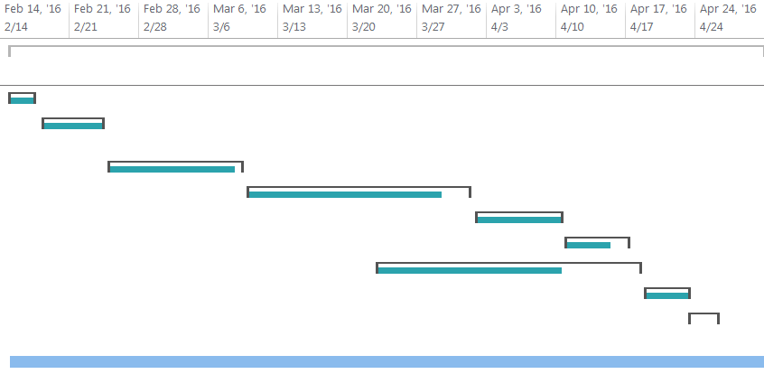
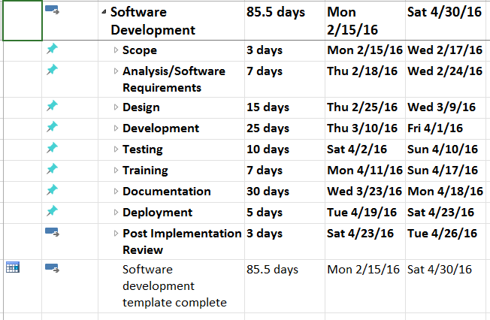
Gantt Chart

Slide 12
Expected Deliverables

